Slide 1


Zuperly Marketing Case study
INCUBATE
Vivan 6.0
Presented by Elite Crew

Slide 2
Table of contents
01
02
03
04
05
06
Problem IDENTification
Market Analysis
Market Targeting
Using Golden Cirlcle Analysis
Based on Market Analysis
Based on various research papers and analysing websites
Branding strategy
Marketing strategy
Call to actions
Focuses on Maximum reach and impressions
Focuses to generate Revanue and do business
What we can start with in current scenario

Slide 3

Identifying the problem
We achieve this by keeping track of students daily schedule, his various subscription and where they consume time the most and make a progress matrix.
WHAT
HOW
Golden Circle Analysis
WHY
What makes us special and unique than peers is we provide everything at a single platform analysis, status tracking and refreshment
We want to help each student to get actual insights in their daily routine, daily progress, also helping

Slide 4
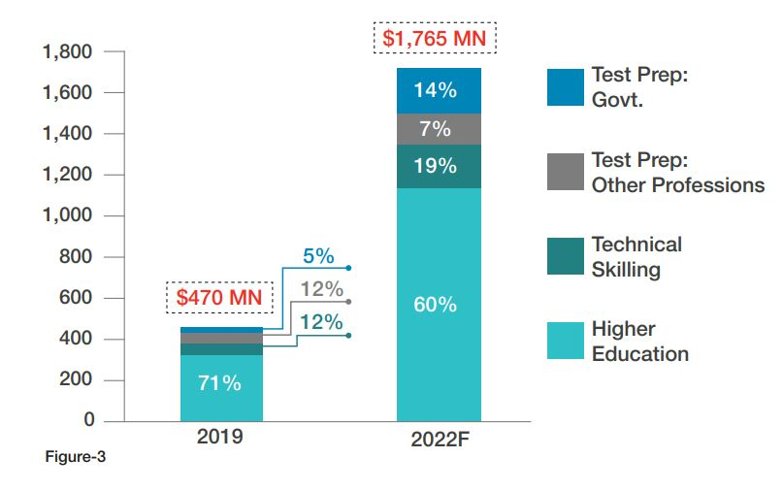
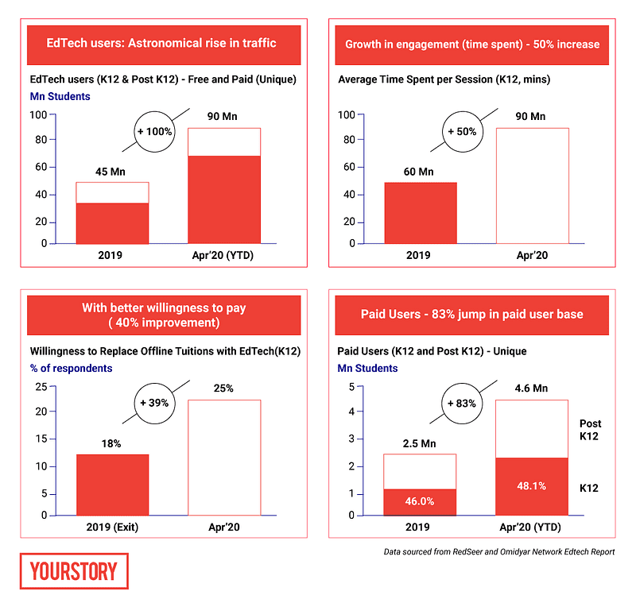
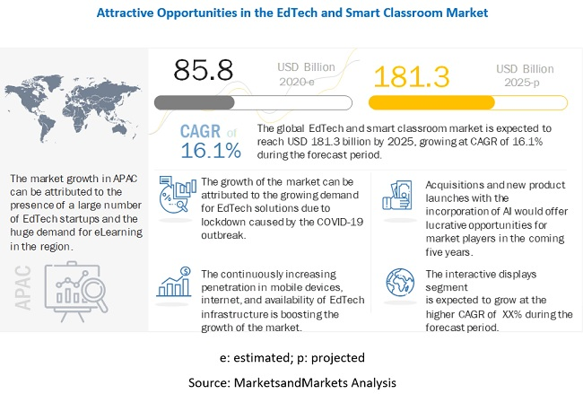
Market analysis

Slide 5

Market targeting
16 - 18
19 - 25
25 - 30
16 - 30
Teen as this people are observing the maximum change in their daily routine of study.
Youngsters as this group is actively looking for a help to manage their schedules
80% working people where they need such app which can make their work-life balance.
Making Our Target audience of age group 16 – 30 years

Slide 6


Branding
SOCIAL MEDIA PLATFORMS
Video broadcasting platforms
Short vine videos
Value SMO strategies
Highly demanded YouTube Influencers.(60% of internet traffic)
Urban Branding using flyers and video posters at high traffic places.
OTT platforms branding Zuperly as the only escape plan of your trouble.
Purpose behind Social Media Branding should be WHY is Zuperly unique and special.

Slide 7

Marketing strategy
Freemium for schools
Freemium for students
Asking Higher Secondary schools for using Zuperly as their daily assesment
VIa Branding, give students free access to dashboards and making Zuperly, a habit for them.
Freemium for enterprise
Selling to edtech companies
Providing personalized dashboards to the employees of huge corporate firms. So that they can make their employees lear and earn at the same time.
Selling few features of Zuperly as a widget tool which can act as Ad-in in their personalized dashboards

Slide 8

Call to actions
 | 1st Quarter | 2nd Quarter | 3rd Quarter
Key action 01 | Working on Branding strategies and making a habit of students to use Zuperly and creating a big database of users. | Maximising the reach and impressions over the subs by giving freemiums and using marketing strategies. While maintain the image of Zuperly a superior and only option to user. | Turning existing customer base into paid subscribers by showing them premium features. Also work with enterprises to buy our subscription
Key action 02 | Using Freemium strategies with branding strategies to penetrate marketing, also asking Top Institute’s student to use our BETA version and give feedback. | Turn Freebies into monthly subscriptions which will be paid and dashboards can be customised | Focus on Word of mouth marketing and pamper existing subs, so as to attract new faithful subs.

Slide 9
Thank you
We Are Open For Questions
Presented by Elite Crew

